Slide 1
Behavioural & Experimental Economics Introduction
Adrien Fillon & Lunzheng Li
University of Cyprus

Slide 2
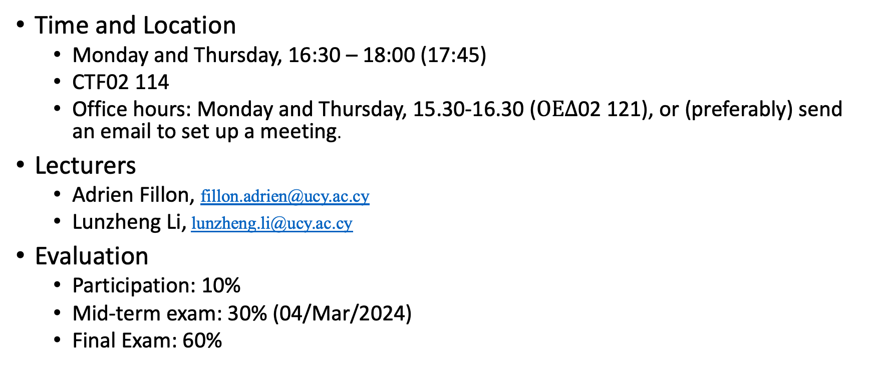
Course Description
Time and Location
Monday and Thursday, 16:30 – 18:00 (17:45)
CTF02 114
Office hours: Monday and Thursday, 15.30-16.30 ($ΟΕΔ$02 121), or (preferably) send an email to set up a meeting.
Lecturers
Adrien Fillon, fillon.adrien@ucy.ac.cy
Lunzheng Li, lunzheng.li@ucy.ac.cy
Evaluation
Participation: 10%
Mid-term exam: 30% (04/Mar/2024)
Final Exam: 60%

Slide 3
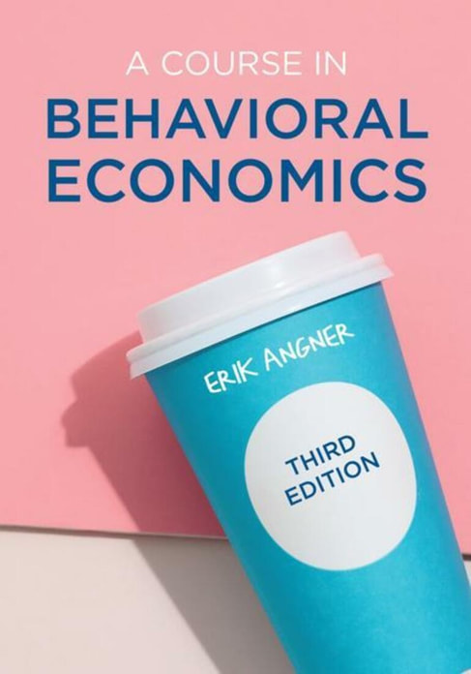
Textbooks and Materials
The course will follow the structure of:
Angner, Erik (2021) A Course in Behavioral Economics, 3rd Ed. (London: Palgrave Macmillan).
https://www.erikangner.com/a-course-in-behavioral-economics.html
Other books that may be helpful are:
Camerer, C & Loewenstein, G & Rabin, M (2003) Advances in Behavioural Economics. (Princeton University Press)
Thaler, R (2003) Quasi rational economics. (Elgar Publishing)
Wilkinson N (2007) An Introduction to Behavioural Economics: A Guide for Students (Palgrave Macmillan)

Slide 4

What is Behavioral Economics?
Economics is a social science that examines how people choose among the alternatives available to them.
Scarcity, Choice, and Cost
https://open.lib.umn.edu/principleseconomics/
Theories of choice/decisions
A descriptive theory describes how people in fact make decisions.
A normative theory captures how people should make decisions.

Slide 5
Descriptive vs. Normative
Consider the following claims. Are they descriptive or normative?
On average, people save less than 10 percent of their income for retirement.
People do not save as much for retirement as they should.
Very often, people regret not saving more for retirement.

Slide 6
Theories of rational choice
Caution: Rationality will have a very specific meaning for us!
Is a theory of rational choice descriptive or normative?
Neoclasical economics: a theory of rational choice is
descriptively adequate
normatively correct
Behavioral economics: a theory of rational choice is
descriptively NOT adequate
BUT STILL normatively correct

Slide 7
Behavioral Economics
The attempt to increase the explanatory and predictive power of economics by providing it with more psychologically plausible foundations – where ‘psychologically plausible’ means consistent with the best available psychological theory.
- Angner, Erik (2021)

Slide 8
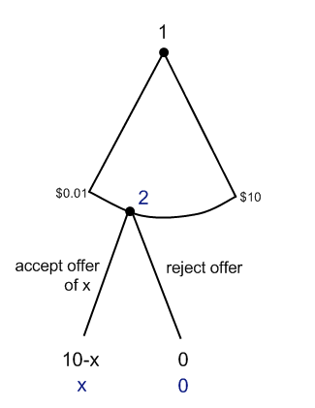
The Ultimatum Game
If you are player 1, how much would you offer?

Slide 9
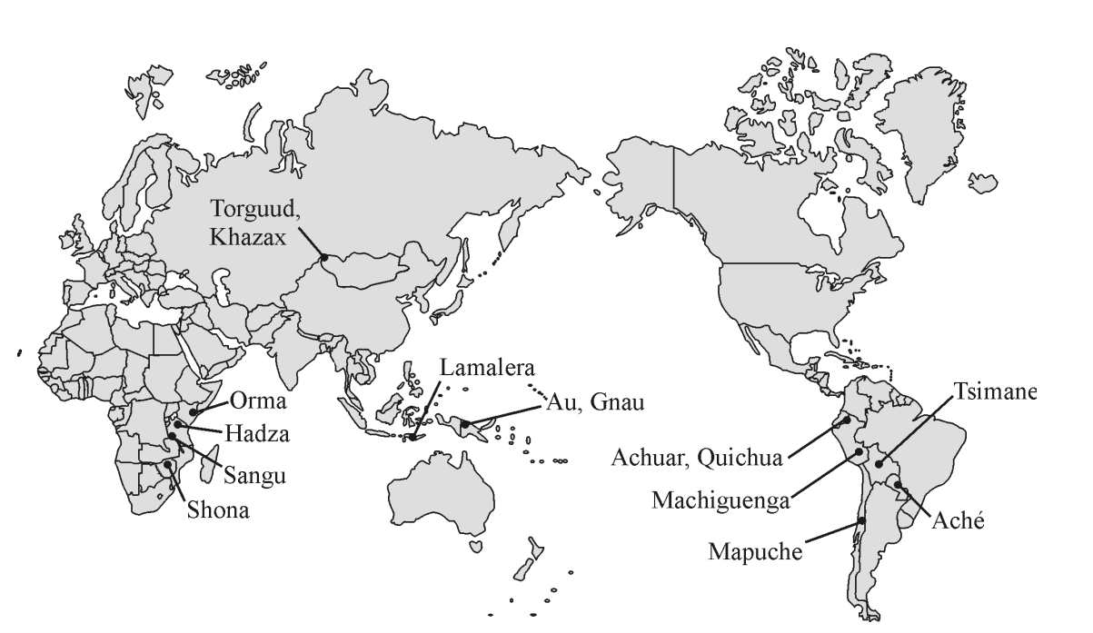
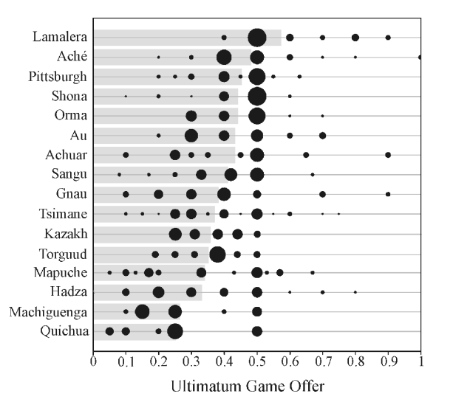
Henrich, Joseph, et al. "“Economic man” in cross-cultural perspective: Behavioral experiments in 15 small-scale societies." Behavioral and brain sciences 28.6 (2005): 795-815.

Slide 10
The Methodology of The Methodology of Behavioral Economics
Laboratory experiments involve real people, choices, and incentives, though in a laboratory setting.
Field experiments randomly assign participants to test and control groups and track how their behavior differs in “the real world.”
Process measures combine these results with brain scans and other data to provide a model of the decision-making process.

Slide 11
Why math?
Consider the following theory:
“People buy the stuff they like more often”

Slide 12
Why math?
Consider the following theory:
“People buy the stuff they like more often”
Sounds reasonable, but it leaves many things open to interpretation:
What if they like something but they can’t afford it?
How do you measure what they like?
What if they like two items equally?

Slide 13
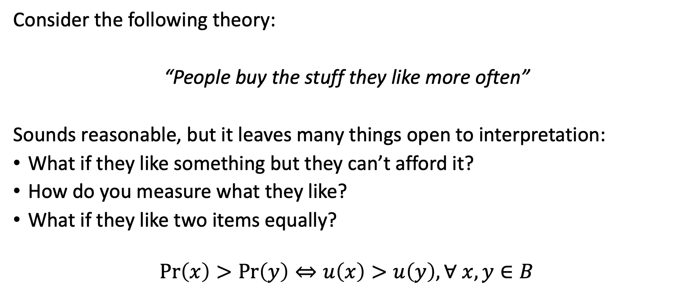
Why math?
Consider the following theory:
“People buy the stuff they like more often”
Sounds reasonable, but it leaves many things open to interpretation:
What if they like something but they can’t afford it?
How do you measure what they like?
What if they like two items equally?
$$\operatorname{Pr}\left(x\right)>\operatorname{Pr}\left(y\right)⇔u\left(x\right)>u\left(y\right), ∀ x,y∈B$$

Slide 14
Behavioral Economics
Psychology & Neurosience
Health
Developmental
Cognitive
Consumer
Clinical
Cross-cultural
Occupational
Evolutionary
Social
Forensic
Educational
Environmental
Neuropsychology
Decision making
Micro
Macro
Behavioral Economics
Finance
Development
Labour
Public
Health
IO
International
Business
Economics

Slide 15
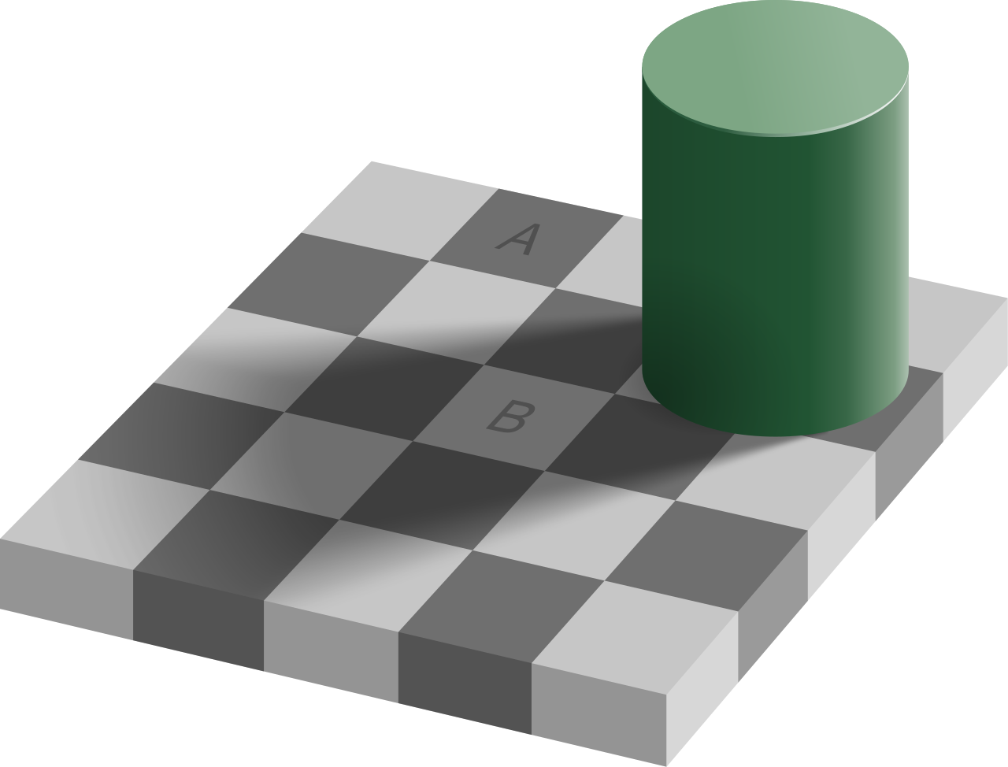

Slide 16


Slide 17
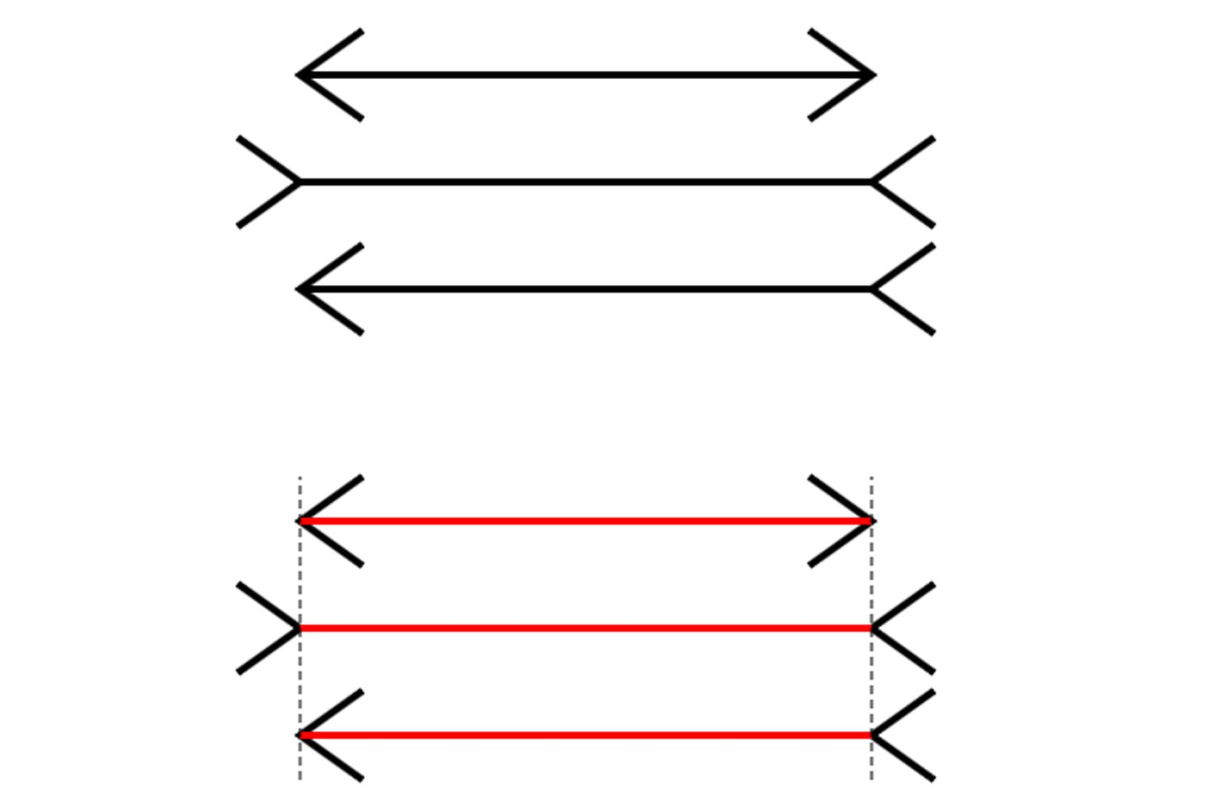

Slide 18

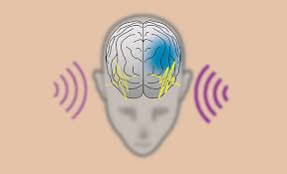

Slide 19
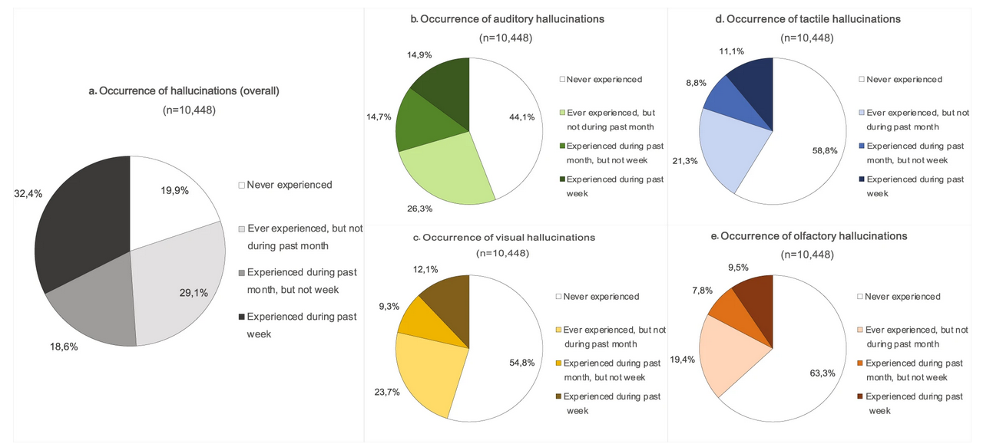
Linszen, M.M.J., de Boer, J.N., Schutte, M.J.L. et al. Occurrence and phenomenology of hallucinations in the general population: A large online survey. Schizophr 8, 41 (2022). https://doi.org/10.1038/s41537-022-00229-9

Slide 20
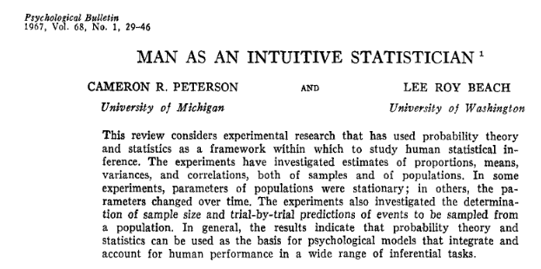
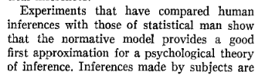
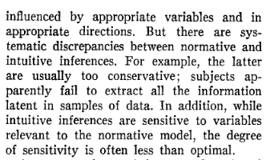

Slide 21
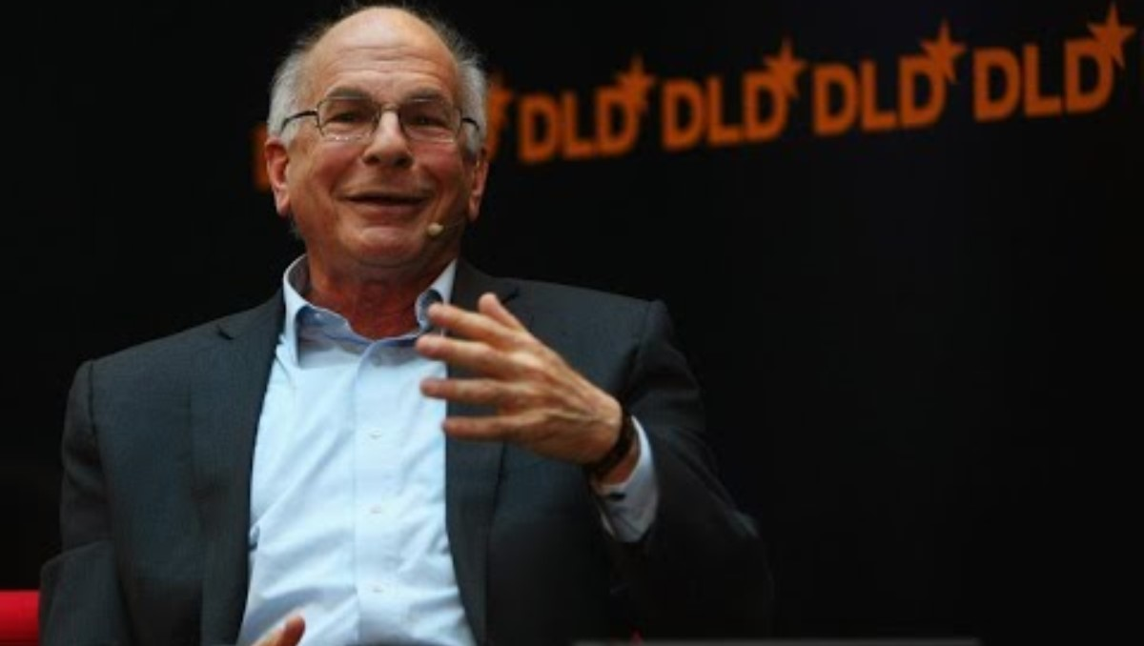

Slide 22

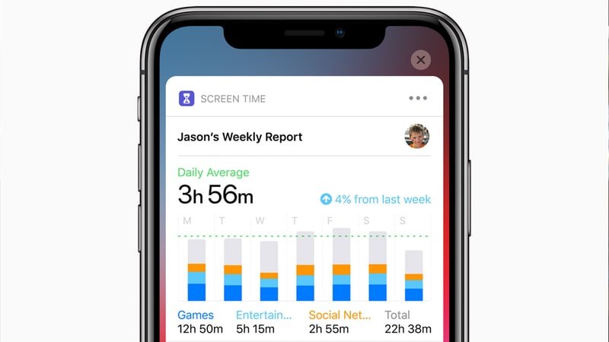


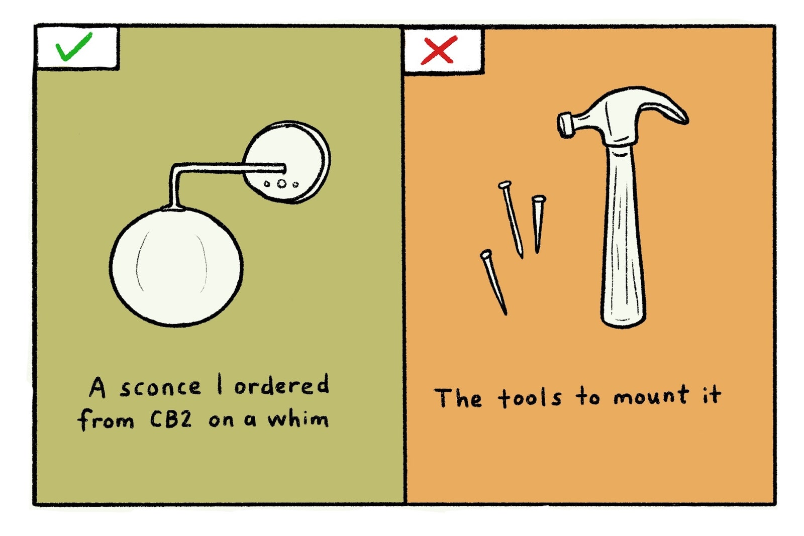
We are good Judge, but with systematic deviation
Notes:
We use more social medias that we would like to
We stay in the same job we don't like
We keep buying stuff we don't need and forget to buy stuff we need
Once something happens, we tell to ourselves (or others) that we knew it – the hindsight bias or the "I knew it all along" bias.

Slide 23
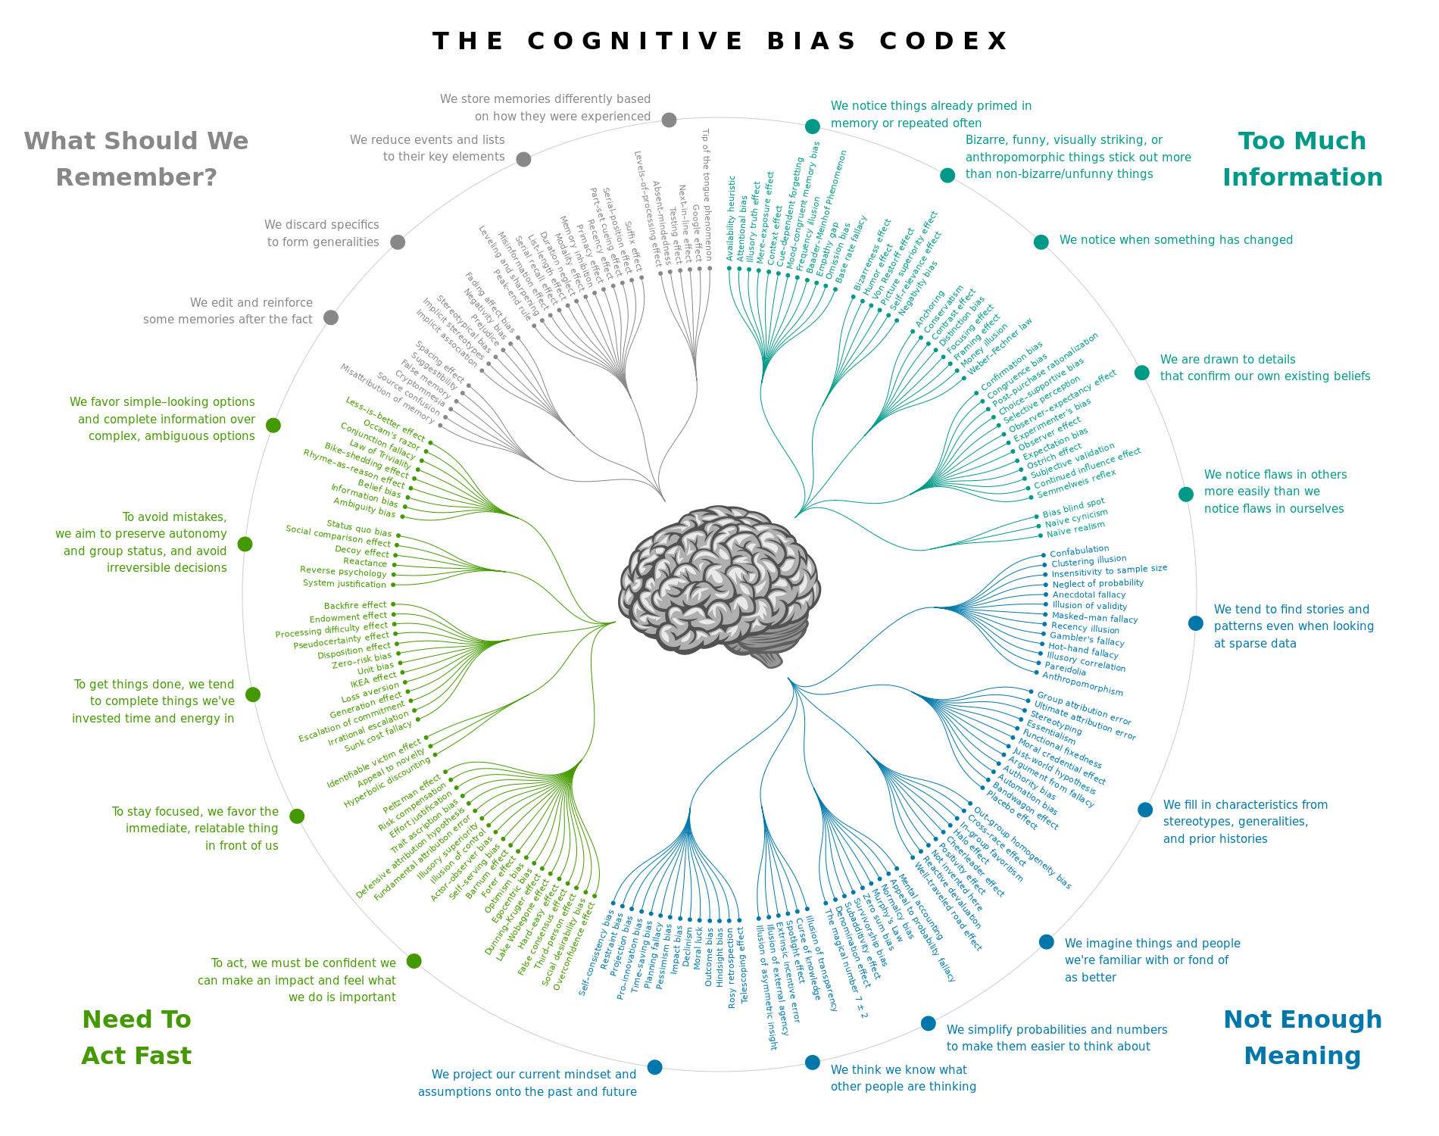

Slide 24

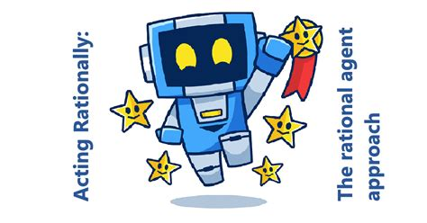

Slide 25
Using math and modelization to understand decision-making
Rational decision making
The economics side
Decisions made by humans
The psychology side
How they are aligned and also how they can systematically differ
How we can use this systematic discrepancy to improve daily behavior, our philosophy or life and policy-making

Slide 26
Course Outline
Choice under Certainty
Judgement under Risk & Uncertainty
Choices under Risk & Uncertainty
Experimental Design and Methodology
Intertemporal Choice
Strategic Interaction
Policy Applications

